Slide 1
Software Engineering
UNIT-V
B.Tech (CSE)-IV SEM
Dept of CSE

Slide 2

UNIT-V:
Software Project Estimation: Decomposition techniques, Empirical Estimation Models,
Maintenance: Maintenance Process, Reengineering, Configuration Management.
Metrics for Products: Software Measurement, Metrics for software quality,
Quality Management: Quality concepts, Software Reviews, Formal technical reviews,
SEI-CMM Model, Six Sigma and ISO 9000 quality standards.
SRI VASAVI ENGINEERING COLLEGE
PEDATADEPALLI, TADEPALLIGUDEM-534 101
Department of Computer Science & Engineering
Academic Year:2022-23
Course Title: Software Engineering
Course Code: V20CST07
Semester:IV
Syllabus

Slide 3
1. METRICS FOR PRODUCTS
Dept of CSE

Slide 4
Software Measurement:
To assess the quality of the engineered product or system and to better understand the models that are created, some measures are used.
These measures are collected throughout the software development life cycle with an intention to improve the software process on a continuous basis.
Measurement helps in estimation, quality control, productivity assessment and project control throughout a software project.
Also, measurement is used by software engineers to gain insight into the design and development of the work products. In addition, measurement assists in strategic decision-making as a project proceeds.
Dept of CSE

Slide 5
Classification of Software Measurement:
There are 2 types of software measurement:
Direct Measurement: In direct measurement, the product, process, or thing is measured directly using a standard scale.
ex: In physical world- length of a bolt
In software- lines of code (LOC) produced,
execution speed, memory size, and
defects reported
Indirect Measurement: In indirect measurement, the quantity or quality to be measured is measured using related parameters
ex: In physical world- quality of bolt
In software- functionality, quality, complexity, efficiency, reliability, maintainability, and many other
Dept of CSE

Slide 6
Software Metrics
A software metric is a measure of software characteristics.
software metric are measurable or countable.
Ex: Physical world- for length-mm, cm, m, feet
software-for size-LOC, Function Points.
Classification of Software Metrics:
There are 3 types of software metrics
Product Metrics: These are the measures of various characteristics of the software product.
The two important software characteristics are:
  Size and complexity of software.
  Quality and reliability of software.
Dept of CSE

Slide 7
Process Metrics: These are the measures of various characteristics of the software development process. They are used to measure the characteristics of methods, techniques, and tools that are used for developing software.
For example, the efficiency of fault detection.
Project metrics: Project metrics are the metrics used by the project manager to check the project's progress.
Ex: Number of software developers, Cost and
schedule , Productivity.
Based on project metrics the manager can take necessary actions to reduce cost and time and to improve quality.
Dept of CSE

Slide 8
1) Size Oriented Metrics:
Size-oriented metrics are a direct measure of software and the development process. Effort (time), money spent, KLOC (thousands of lines of code), pages of documentation written, errors, and individuals on the project are examples of these measures.
If a software company keeps simple records, we can make a table of Size Oriented metrics like the one below.
Dept of CSE

Slide 9
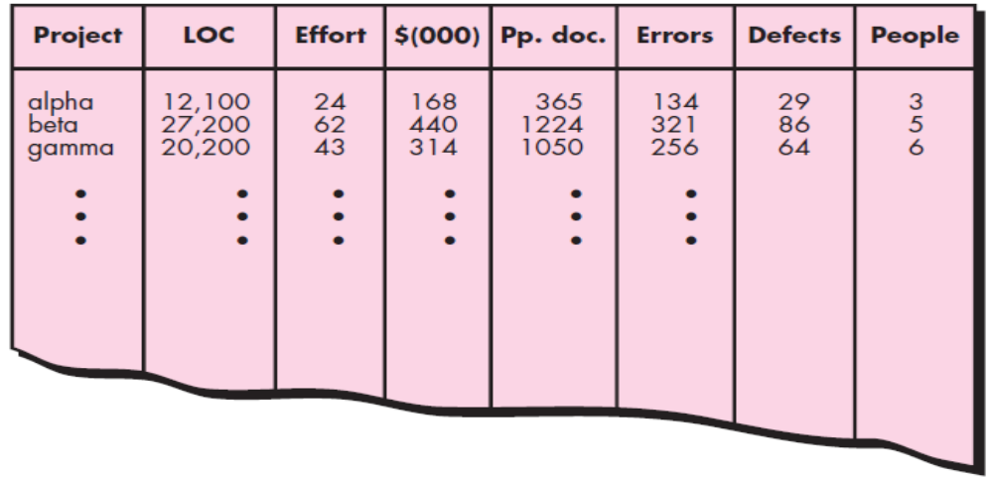
Referring to the table entry for project alpha: 12,100 lines of code were developed with 24 person-months of effort at a cost of $168,000 it also indicates that 365 pages of documentation were developed, 134 errors were recorded before the software was released, and 29 defects were encountered after release to the customer within the first year of operation. Three people worked on the development of software for project alpha.
Dept of CSE

Slide 10
To compare similar metrics from other projects, you can choose lines of code as a normalization value.
set of simple size-oriented metrics can be developed for each project:
  Errors per KLOC (thousand lines of code)
  Defects per KLOC
  $ per KLOC
  Pages of documentation per KLOC
In addition, other interesting metrics can be computed:
  Errors per person-month
  KLOC per person-month
  $ per page of documentation
Size-oriented metrics are not universally accepted as the best way to measure the software process.
Dept of CSE

Slide 11
2) Function-Oriented Metrics:
Function-oriented software metrics use a measure of the functionality delivered by the application as a normalization value.
The most widely used function-oriented metric is the function point (FP).
Computation of the function point is based on characteristics of the software’s information domain and complexity.
The function point, like the LOC measure, is controversial.
  Proponents claim that FP is programming language independent, making it ideal for application using conventional and nonprocedural languages, and that it is based on data that are more likely to be known early in the evolution of a project, making FP more attractive as an estimation approach.
Dept of CSE

Slide 12
  Opponents claim that the method requires some “sleight of hand ” in that computation is based subjective rather than objective data, that counts of the information domain can be difficult to collect after the fact, and that FP has no direct physical meaning- it’s just a number.
Typical Function-Oriented Metrics:
➢ errors per FP (thousand lines of code)
➢ defects per FP
➢ $ per FP
➢ pages of documentation per FP
➢ FP per person-month
  Calculating Function points will be discussed in the coming topics
Dept of CSE

Slide 13
3) Object Oriented Metrics:
Conventional software project metrics (LOC or FP) can be used to estimate object oriented software projects.
However, these metrics do not provide enough granularity for the schedule and effort adjustments that are required as you iterate through an evolutionary or incremental process.
Lorenz and Kidd suggest the following set of metrics for OO projects:
Number of scenario scripts: A scenario script is a detailed sequence of steps that describes the interaction between the user and the application.
Each script is organized into triplets of the form
{initiator, action, participant}
Dept of CSE

Slide 14
where initiator is the object that requests some service (that initiates a message), action is the result of the request, and participant is the server object that satisfies the request.
The number of scenario scripts is directly correlated to the size of the application and to the number of test cases that must be developed to exercise the system once it is constructed.
Number of key classes. Key classes are the “highly independent components” that are defined early in object-oriented analysis . Because key classes are central to the problem domain, the number of such classes is an indication of the amount of effort required to develop the software and also an indication of the potential amount of reuse to be applied during system development.
Dept of CSE

Slide 15
Number of support classes. Support classes are required to implement the system but are not immediately related to the problem domain. Examples might be user interface (GUI) classes, database access and manipulation classes, and computation classes.
Average number of support classes per key class. In general, key classes are known early in the project. Support classes are defined throughout. If the average number of support classes per key class were known for a given problem domain, estimating (based on total number of classes) would be greatly simplified.
Number of subsystems. A subsystem is an aggregation of classes that support a function that is visible to the end user of a system. Once subsystems are identified, it is easier to lay out a reasonable schedule in which work on subsystems is partitioned among project staff.
Dept of CSE

Slide 16
4) Use-Case–Oriented Metrics:
Use-cases describe (indirectly) user-visible functions and features in language independent manner.
It would seem reasonable to use the use case as a normalization measure similar to LOC or FP.
the number of use cases is directly proportional to the size of the application in LOC and to the number of test cases that will have to be designed to fully exercise the application.
However use cases do not come in standard sizes and use as a normalization measure is suspect .
Use case points have been suggested as a mechanism for estimating effort.
Dept of CSE

Slide 17
5) WebApp Project Metrics:
The objective of all web engineering projects is to build a Web application that delivers a combination of content and functionality to the end-user.
measures that can be used in WebApp Project Metrics are:
Number of static Web pages. Web pages with static content (i.e., the end user has no control over the content displayed on the page) are the most common of all WebApp features. These pages represent low relative complexity and generally require less effort to construct than dynamic pages. This measure provides an indication of the overall size of the application and the effort required to develop it.
Dept of CSE

Slide 18
Number of dynamic Web pages. Web pages with dynamic content (i.e., end-user actions or other external factors result in customized content displayed on the page) are essential in all e-commerce applications, search engines, financial applications, and many other. These pages represent higher relative complexity and require more effort to construct than static pages. This measure provides an indication of the overall size of the application and the effort required to develop it.
Number of internal page links. Internal page links are pointers that provide a hyperlink to some other Web page within the WebApp. This measure provides an indication of the degree of architectural coupling within the WebApp. As the number of page links increases, the effort expended on navigational design and construction also increases.
Dept of CSE

Slide 19
Number of persistent data objects. One or more persistent data objects (e.g., a database or data file) may be accessed by a WebApp. As the number of persistent data objects grows, the complexity of the WebApp also grows and the effort to implement it increases proportionally.
Number of external systems interfaced. WebApps must often interface with “backroom” business applications. As the requirement for interfacing grows, system complexity and development effort also increase.
Number of static content objects. Static content objects encompass static text-based, graphical, video, animation, and audio information that are incorporated within the WebApp. Multiple content objects may appear on a single Web page.
Dept of CSE

Slide 20
Number of dynamic content objects. Dynamic content objects are generated based on end-user actions and encompass internally generated textbased, graphical, video, animation, and audio information that are incorporated within the WebApp. Multiple content objects may appear on a single Web page.
Number of executable functions. An executable function (e.g., a script or applet) provides some computational service to the end user. As the number of executable functions increases, modeling and construction effort also increase.
Dept of CSE

Slide 21
Metrics For Software Quality:
The main goal of software engineering is to produce a high-quality system, application, or product within a time frame that satisfies a market need.
To achieve this goal, you must apply effective methods coupled with modern tools to the software process.
A project manager must evaluate quality of the software as the project progresses.
There is a number of metrics available based on which software quality is measured. But among them, there are a few most useful metrics which are essential in software quality measurement. They are –
Dept of CSE

Slide 22
1) Code Quality – Code quality metrics measure the quality of code used for software project development. Maintaining the software code quality by writing Bug-free and semantically correct code is very important for good software project development. In code quality, both Quantitative metrics like the number of lines, complexity, functions, rate of bugs generation, etc, and Qualitative metrics like readability, code clarity, efficiency, and maintainability, etc are measured.
2) Reliability – Reliability metrics express the reliability of software in different conditions. The software is able to provide exact service at the right time or not checked. Reliability can be checked using Mean Time Between Failure (MTBF) and Mean Time To Repair (MTTR).
Dept of CSE

Slide 23
3) Performance – Performance metrics are used to measure the performance of the software. Each software has been developed for some specific purposes. Performance metrics measure the performance of the software by determining whether the software is fulfilling the user requirements or not, by analyzing how much time and resource it is utilizing for providing the service.
4) Usability – Usability metrics check whether the program is user-friendly or not. Each software is used by the end-user. So it is important to measure that the end-user is happy or not by using this software.
5) Correctness – Correctness is one of the important software quality metrics as this checks whether the system or software is working correctly without any error by satisfying the user. Correctness gives the degree of service each function provides as per developed.
Dept of CSE

Slide 24
6)Maintainability – Each software product requires maintenance and up-gradation. Maintenance is an expensive and time-consuming process. So if the software product provides easy maintainability then we can say software quality is up to mark. Maintainability metrics include the time required to adapt to new features/functionality, Mean Time to Change (MTTC), performance in changing environments, etc.
7) Integrity – Software integrity is important in terms of how much it is easy to integrate with other required software which increases software functionality and what is the control on integration from unauthorized software’s which increases the chances of cyber attacks.
8) Security – Security metrics measure how secure the software is. In the age of cyber terrorism, security is the most essential part of every software. Security assures that there are no unauthorized changes, no fear of cyber attacks, etc when the software product is in use by the end-user.
Dept of CSE

Slide 25
2. Quality Management
Dept of CSE

Slide 26
Quality Concepts:
What Is Quality?
According to David Garvin Quality is a “quality is a complex and multifaceted concept” that can be described from five different points of view.
  The transcendental view that quality is something that you immediately recognize, but cannot explicitly define.
  The user view sees quality in terms of an end user’s specific goals. If a product meets those goals, it exhibits quality.
  The manufacturer’s view defines quality in terms of the original specification of the product. If the product conforms to the spec, it exhibits quality.
  The product view suggests that quality can be tied to inherent characteristics (e.g., functions and features) of a product.
  Finally, the value-based view measures quality based on how much a customer is willing to pay for a product.
In reality, quality encompasses all of these views and more.
Dept of CSE

Slide 27
2. Software Quality:
Software quality can be defined as:
“An effective software process applied in a manner that creates a useful product that provides measurable value for those who produce it and those who use it.”
The way we define quality is subjective. There's no single right definition for quality; each person has their own definition based on personal experiences.
So, how good is our definition of quality? If someone asks about "quality," what should they look out for? We must know different people views regarding the definition of quality.
Dept of CSE

Slide 28
2.1 Garvin’s Quality Dimensions:
Garvin proposes eight critical dimensions or categories of quality that can serve as a framework for strategic analysis: Performance, features, reliability, conformance, durability, serviceability, aesthetics, and perceived quality.
Performance quality. Does the software deliver all content, functions, and features that are specified as part of the requirements model in a way that provides value to the end user?
For a car, performance would include characteristics like millage per gallon, acceleration, handling, cruising speed etc.
Feature quality. Does the software provide features that surprise and delight first-time end users?
For a car, features would include the built-in GPS, seat warmer, smartphone integration etc.
Dept of CSE

Slide 29
Reliability. Does the software deliver all features and capability without failure? Is it available when it is needed? Does it deliver functionality that is error-free?
Conformance. Does the software conform to local and external software standards that are relevant to the application? Does it conform to de facto design and coding conventions? For example, does the user interface conform to accepted design rules for menu selection or data input?.
Durability. Can the software be maintained (changed) or corrected (debugged) without the inadvertent generation of unintended side effects? Will changes cause the error rate or reliability to degrade with time?
Dept of CSE

Slide 30
Serviceability. Can the software be maintained (changed) or corrected (debugged) in an acceptably short time period? Can support staff acquire all information they need to make changes or correct defects?
Serviceability is the ease at which a user can repair a faulty product or get it fixed.
Aesthetics Aesthetics refers to the appearance of a product or service. It includes all aspects related to the physical appearance of a product, for example, the weight, colour, size, texture, packaging design etc.
Perceived Quality is the overall opinion of the customers towards the product. It's the combined effects of factors such as brand name, price, salesperson, marketing strategy etc.
Example: When was the last time you had a positive experience with a bank?
Dept of CSE

Slide 31
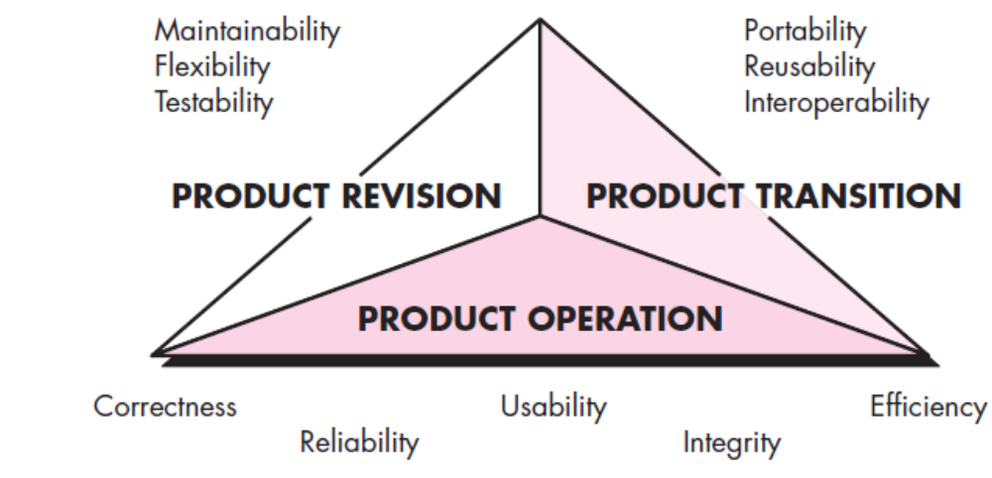
2.2 McCall’s Quality Factors
McCall, Richards, and Walters propose a useful categorization of factors that affect software quality.
These software quality factors, shown in Figure ,
focus on three important aspects of a software product: its operational characteristics, its ability to undergo change, and its adaptability to new environments.
Dept of CSE

Slide 32
McCall and his colleagues provide the following descriptions:
Correctness. The extent to which a program satisfies its specification and fulfills the customer’s mission objectives.
Reliability. The extent to which a program can be expected to perform its intended function with required precision.
Efficiency. The amount of computing resources and code required by a program to perform its function.
Integrity. Extent to which access to software or data by unauthorized persons can be controlled.
Usability. Effort required to learn, operate, prepare input for, and interpret output of a program.
Maintainability. Effort required to locate and fix an error in a program.
Flexibility. Effort required to modify an operational program.
Dept of CSE

Slide 33
Testability. Effort required to test a program to ensure that it performs its intended function.
Portability. Effort required to transfer the program from one hardware and/or software system environment to another.
Reusability. Extent to which a program [or parts of a program] can be reused in other applications—related to the packaging and scope of the functions that the program performs.
Interoperability. Effort required to couple one system to another.
It is difficult, and in some cases impossible, to develop direct measures of these quality factors. In fact, many of the metrics defined by McCall et al. can be measured only indirectly. However, assessing the quality of an application using these factors will provide you with a solid indication of software quality.
Dept of CSE

Slide 34
2.3 ISO 9126 Quality Factors:
The ISO 9126 standard was developed in an attempt to identify the key quality attributes for computer software. The standard identifies six key quality attributes:
Functionality. The degree to which the software satisfies stated needs as indicated by the following subattributes: suitability, accuracy, interoperability,compliance, and security.
Reliability. The amount of time that the software is available for use as indicated by the following subattributes: maturity, fault tolerance, recoverability.
Usability. The degree to which the software is easy to use as indicated by the following subattributes: understandability, learnability, operability.
Dept of CSE

Slide 35
Efficiency. The degree to which the software makes optimal use of system resources as indicated by the following subattributes: time behavior, resource behavior.
Maintainability. The ease with which repair may be made to the software as indicated by the following subattributes: analyzability, changeability, stability, testability.
Portability. The ease with which the software can be transposed from one environment to another as indicated by the following subattributes: adaptability, installability, conformance, replaceability.
Dept of CSE

Slide 36
2.3 Achieving Software Quality:
Software quality doesn’t just appear. It is the result of good project management and solid software engineering practice.
Management and practice are applied within the context of four broad activities that help a software team achieve high software quality:
  software engineering methods,
  project management techniques,
  Quality control actions, and
  software quality assurance.
Dept of CSE

Slide 37
Software Engineering Methods:
We are having a wide array of concepts and methods that can lead to a reasonably complete understanding of the problem and a comprehensive design that establishes a solid foundation for the construction activity. If you apply those concepts and adopt appropriate analysis and design methods, the likelihood of creating high-quality software will increase substantially.
Project Management Techniques:
If the project manager follows the project management techniques The implications are clear: if (1) the project manager uses estimates to ensure delivery dates are met, (2) schedule dependencies are understood and the team resists the temptation to take shortcuts, (3) risk planning occurs so that problems arise. does not cause chaos, the quality of the software is positively affected.
Dept of CSE

Slide 38
Quality Control:
  Quality control encompasses a set of software engineering actions that help to ensure that each work product meets its quality goals.
  Models are reviewed to ensure that they are complete and consistent. Code may be inspected in order to uncover and correct errors before testing commences.
  A series of testing steps is applied to uncover errors in processing logic, data manipulation, and interface communication.
  A combination of measurement and feedback allows a software team to tune the process when any of these work products fail to meet quality goals
Dept of CSE

Slide 39
Quality Assurance:
  Quality assurance establishes the infrastructure that supports solid software engineering methods, rational project management, and quality control actions—all pivotal if you intend to build high-quality software.
  In addition, quality assurance consists of a set of auditing and reporting functions that assess the effectiveness and completeness of quality control actions.
  The goal of quality assurance is to provide management and technical staff with the data necessary to be informed about product quality, thereby gaining insight and confidence that actions to achieve product quality are working. Of course, if the data provided through quality assurance identifies problems, it is management’s responsibility to address the problems and apply the necessary resources to resolve quality issues.
Dept of CSE

Slide 40
3. Review Techniques

Slide 41
3.1 Informal Reviews:
Informal reviews include a simple desk check of a software engineering work product with a colleague, a casual meeting (involving more than two people) for the purpose of reviewing a work product.
A simple desk check or a casual meeting conducted with a colleague is a review. However, because there is no advance planning or preparation, no agenda or meeting structure, and no follow-up on the errors that are uncovered, the effectiveness of such reviews is considerably lower than more formal approaches. But a simple desk check can and does uncover errors that might otherwise propagate further into the software process.

Slide 42
One way to improve the efficacy of a desk check review is to develop a set of simple review checklists for each major work product produced by the software team. The questions posed within the checklist are generic, but they will serve to guide the reviewers as they check the work product.
For example, let’s reexamine a desk check of the interface prototype for SafeHomeAssured.com. Rather than simply playing with the prototype at the designer’s workstation, the designer and a colleague examine the prototype using a checklist for interfaces:
  Is the layout designed using standard conventions? Left to right? Top to bottom?
  Does the presentation need to be scrolled?
  Are color and placement, typeface, and size used effectively?
  Are all navigation options or functions represented at the same level of abstraction?
  Are all navigation choices clearly labeled?

Slide 43
Any errors or issues noted by the reviewers are recorded by the designer for resolution at a later time.
Desk checks may be scheduled in an ad hoc manner, or they may be mandated as part of good software engineering practice.
In general, the amount of material to be reviewed is relatively small and the overall time spent on a desk check spans little more than one or two hours.

Slide 44
3.2 Formal Technical Reviews:
A formal technical review (FTR) is a software quality control activity performed by software engineers (and others).
The objectives of an FTR are:
  (1) to uncover errors in function, logic, or implementation for any representation of the software;
  (2) to verify that the software under review meets its requirements;
  (3) to ensure that the software has been represented according to predefined standards;
  (4) to achieve software that is developed in a uniform manner; and
  (5) to make projects more manageable.

Slide 45
In addition, the purpose of FTR is to enable junior engineers to observe the analysis, design, coding and testing approach more closely.
FTR also works to promote back up and continuity become familiar with parts of software they might not have seen otherwise.
Actually, FTR is a class of reviews that include walkthroughs, inspections, round robin reviews and other small group technical assessments of software.
Each FTR is conducted as meeting and is considered successful only if it is properly planned, controlled and attended.

Slide 46
Steps required to conduct a successful FTR:
1) The review meeting: Each review meeting should be held considering the following constraints- Involvement of people:
  Between 3, 4 and 5 people should be involve in the review.
  Advance preparation should occur but it should be very short that is at the most 2 hours of work for every person.
  The short duration of the review meeting should be less than two hour. Gives these constraints, it should be clear that an FTR focuses on specific (and small) part of the overall software.
At the end of the review, all attendees of FTR must decide what to do.
  Accept the product without any modification.
  Reject the project due to serious error (Once corrected, another app need to be reviewed), or

Slide 47
  Accept the product provisional (minor errors are encountered and should be corrected, but no additional review will be required).
The decision was made, with all FTR attendees completing a sign-of indicating their participation in the review and their agreement with the findings of the review team.
2) Review reporting and record keeping :-
During the FTR, the reviewer actively records all issues that have been raised.
At the end of the meeting all these issues raised are consolidated and a review list is prepared.
Finally, a formal technical review summary report is prepared.
It answers three questions :-
  What was reviewed ?
  Who reviewed it ?
  What were the findings and conclusions ?

Slide 48
3) Review guidelines :- Guidelines for the conducting of formal technical reviews should be established in advance. These guidelines must be distributed to all reviewers, agreed upon, and then followed. A review that is unregistered can often be worse than a review that does not minimum set of guidelines for FTR.
  Review the product, not the manufacture (producer).
  Take written notes (record purpose)
  Limit the number of participants and insists upon advance preparation.
  Develop a checklist for each product that is likely to be reviewed.
  Allocate resources and time schedule for FTRs in order to maintain time schedule.

Slide 49
  Conduct meaningful training for all reviewers in order to make reviews effective.
  Reviews earlier reviews which serve as the base for the current review being conducted.
  Set an agenda and maintain it.
  Separate the problem areas, but do not attempt to solve every problem notes.
  Limit debate and rebuttal.

Slide 50
4. Quality Standards

Slide 51
4.1 Software Engineering Institute- Capability Maturity Model (SEI-CMM)
SEICMM is expanded as ‘Software Engineering Institute Capability Maturity Model’, and it was produced in 1987 at the Carnegie Mellon University by the SEI (Software Engineering Institute) themselves.
It is not a software process model. It is a framework that is used to analyze the approach and techniques followed by any organization to develop software products.
It also provides guidelines to further enhance the maturity of the process used to develop those software products.
The Capability Maturity Model (CMM) is a procedure used to develop and refine an organization's software development process.

Slide 52
The Software Engineering Institute (SEI) Capability Maturity Model (CMM) specifies an increasing series of levels to a software development organization.
The higher the level, the better the software development process, hence reaching each level is an expensive and time-consuming process.
Levels of CMM:
SEI CMM categorized software development industries into the following five maturity levels.
The various levels of SEI CMM have been designed so that it is easy for an organization to build its quality system starting from scratch slowly.
Dept of CSE

Slide 53
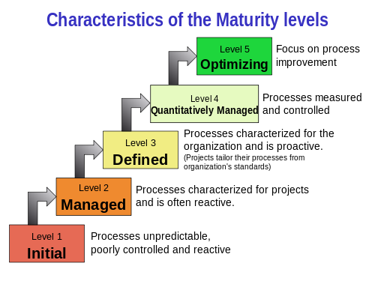
Dept of CSE

Slide 54
Level I: Initial – CMM1
  The organizations in the Initial stage, typically, will not have any KPA’s(Key Process Area’ or the KPA’s are nothing but the minimum requirement set for any software development organization) set, will have lesser quality employees, the management procedure will not be defined clearly, weakly designed control over the development process, the quality of the product will not be as good both in terms of the customer’s convenience and in terms of the technical advancements. Hence these organizations fall under the least level of CMM1 in the SEI CMM.
Dept of CSE

Slide 55
Level II: Repeatable – CMM2
  This level of Software Development Organization has a basic and consistent project management processes to track cost, schedule, and functionality. The process is in place to repeat the earlier successes on projects with similar applications. Program management is a key characteristic of a level two organization.
level III: Well-Defined – CMM3
  The commonly observed characteristics of this type of organizations are that they use definite flow for the development process, creating documentation in each step of the development flow, everyone in the company is well aware of their own roles and responsibilities, organization will be able to deliver a better quality of software product, the employees are made to work as a team and there is a notably structured management process is observed. At the defined level, an organization develops its own standard software development process. These defined processes enable greater attention to documentation, standardization and integration.
Dept of CSE

Slide 56
Level IV: Well Managed – CMM4
  When management is clearly defined and executed, the organization can move to a better level in terms of delivering the quality product, as well as in the financial expansion. The organizations in level IV are the ones that have qualified management and focuses only on the quality of the deliverables. This type of organizations will have various measures for self assessments, both for the product points and the process points.
  At the managed level, an organization monitors and controls its own processes through data collection and analysis.
Dept of CSE

Slide 57
Level V: Optimized – CMM5
  The Key characteristic of this level is focusing on continually improving process performance through both incremental and innovative technological improvements. At this level, changes to the process are to improve the process performance and at the same time maintaining statistical probability to achieve the established quantitative process-improvement objectives.
Dept of CSE

Slide 58
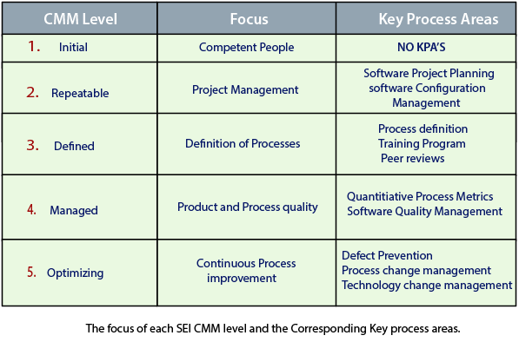
Dept of CSE

Slide 59
4.2 six sigma:
The term "Six Sigma" refers to a statistical measure of how far a process deviates from perfection.
A process that operates at six sigma has a failure rate of only 0.00034%, which means it produces virtually no defects.
Six Sigma was developed by Motorola in the 1980s, and it has since been adopted by many other companies around the world, including General Electric, Toyota, and Amazon.
It is used in industries such as manufacturing, healthcare, finance, and service industries to improve customer satisfaction, reduce costs, and increase profits.
Dept of CSE

Slide 60
What is Six Sigma?
Six Sigma is a set of methodologies and tools used to improve business processes by reducing defects and errors, minimizing variation, and increasing quality and efficiency.
Six Sigma is a highly disciplined process that helps us focus on developing and delivering near-perfect products and services.
Six Sigma is the process of improving the quality of the output by identifying and eliminating the cause of defects and reduce variability in manufacturing and business processes.
A six sigma method is one in which 99.99966% of all the products to be produced have the some features and are of free from defects.
Dept of CSE

Slide 61
Six Sigma Methodologies
Six Sigma projects follow two project methodologies:
  DMAIC
  DMADV
1. DMAIC
  It specifies a data-driven quality strategy for improving processes. This methodology is used to enhance an existing business process.
The DMAIC project methodology has five phases:
  Define
  Measure
  Analyze
  Improve
  Control
Dept of CSE

Slide 62
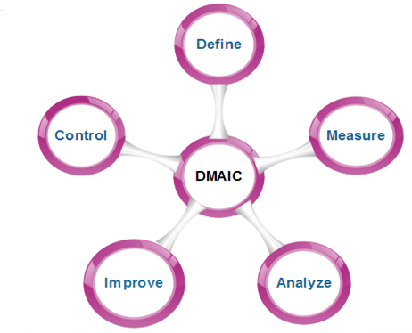
Dept of CSE

Slide 63
The letters stand for:
Define the problem and the project goals
Measure in detail the various aspects of the current process
Analyze data to, among other things, find the root defects in a process
Improve the process
Control how the process is done in the future
Dept of CSE

Slide 64
  2. DMADV
  The DMADV method is typically used to create new processes and new products or services.
The DMADV project methodology has five phases:
  Define
  Measure
  Analyze
  Design
  Verify
Dept of CSE

Slide 65
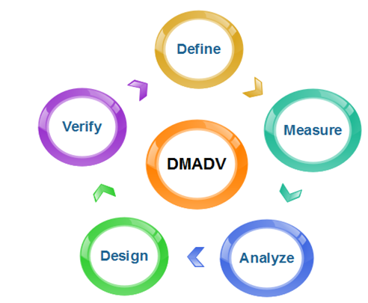
Dept of CSE

Slide 66
The letters stand for:
Define the project goals
Measure critical components of the process and the product capabilities
Analyze the data and develop various designs for the process, eventually picking the best one
Design and test details of the process
Verify the design by running simulations and a pilot program, and then handing over the process to the client
Dept of CSE

Slide 67
4.3 ISO 9000 quality standards.
ISO 9000 is a series of standards, developed and published by the International Organization for Standardization (ISO).
It defines, establishes and maintains an effective quality assurance (QA) system for manufacturing and service industries.
ISO 9000 is defined as a set of international standards on quality management and quality assurance developed to help companies effectively document the quality system elements needed to maintain an efficient quality system. They are not specific to any one industry and can be applied to organizations of any size.
Dept of CSE

Slide 68
ISO (International Standards Organization) is a group or consortium of 63 countries established to plan and fosters standardization.
ISO declared its 9000 series of standards in 1987. It serves as a reference for the contract between independent parties.
The ISO 9000 standard determines the guidelines for maintaining a quality system.
The ISO standard mainly addresses operational methods and organizational methods such as responsibilities, reporting, etc.
ISO 9000 defines a set of guidelines for the production process and is not directly concerned about the product itself.
Dept of CSE

Slide 69
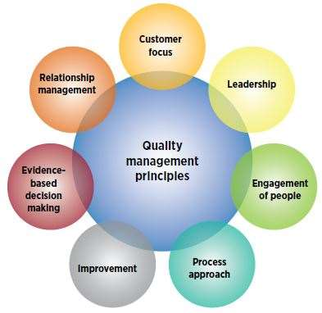
ISO 9000 quality management guidelines
There are seven quality management principles included in ISO 9000:
Dept of CSE

Slide 70
1. Customer focus
  Understand the needs of existing and future customers
  Align organizational objectives with customer needs and expectations
  Meet customer requirements
  Measure customer satisfaction
  Manage customer relationships
  Aim to exceed customer expectations
  Learn more about the customer experience and customer satisfaction
Dept of CSE

Slide 71
2.Leadership
  Establish a vision and direction for the organization
  Set challenging goals
  Model organizational values
  Establish trust
  Equip and empower employees
  Recognize employee contributions
  Learn more about leadership
Dept of CSE

Slide 72
3.Engagement of people
  Ensure that people’s abilities are used and valued
  Make people accountable
  Enable participation in continual improvement
  Evaluate individual performance
  Enable learning and knowledge sharing
  Enable open discussion of problems and constraints
  Learn more about employee involvement
4.Process approach
  Manage activities as processes
  Measure the capability of activities
  Identify linkages between activities
  Prioritize improvement opportunities
  Deploy resources effectively
  Learn more about a process view of work and see process analysis tools
Dept of CSE

Slide 73
5.Improvement
  Improve organizational performance and capabilities
  Align improvement activities
  Empower people to make improvements
  Measure improvement consistently
  Celebrate improvements
  Learn more about approaches to continual improvement
6.Evidence-based decision making
  Ensure the accessibility of accurate and reliable data
  Use appropriate methods to analyze data
  Make decisions based on analysis
  Balance data analysis with practical experience
  See tools for decision making
Dept of CSE

Slide 74
7. Relationship management
  Identify and select suppliers to manage costs, optimize resources, and create value
  Establish relationships considering both the short and long term
  Share expertise, resources, information, and plans with partners
  Collaborate on improvement and development activities
  Recognize supplier successes
  Learn more about supplier quality and see resources related to managing the supply chain
Dept of CSE

Slide 75
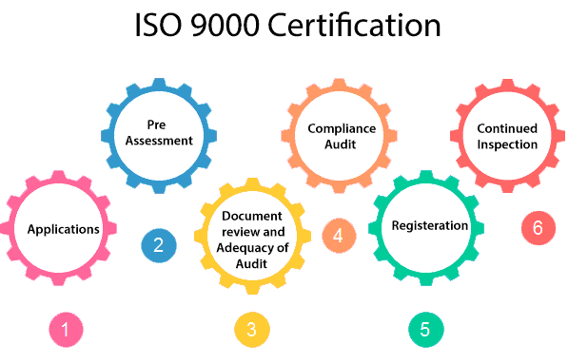
How to get ISO 9000 Certification?
An organization determines to obtain ISO 9000 certification applies to ISO registrar office for registration. The process consists of the following stages:
Dept of CSE

Slide 76
Application: Once an organization decided to go for ISO certification, it applies to the registrar for registration.
Pre-Assessment: During this stage, the registrar makes a rough assessment of the organization.
Document review and Adequacy of Audit: During this stage, the registrar reviews the document submitted by the organization and suggest an improvement.
Compliance Audit: During this stage, the registrar checks whether the organization has compiled the suggestion made by it during the review or not.
Registration: The Registrar awards the ISO certification after the successful completion of all the phases.
Continued Inspection: The registrar continued to monitor the organization time by time.
Dept of CSE

Slide 77
5. Software Project Estimation
Dept of CSE

Slide 78
5.1 Introduction:
software project estimation is a crucial process that revolves around predicting the project’s time and effort, cost, and scope; all this information is necessary for the planning stage and to ensure the project’s success.
Too many variables—human, technical, environmental, political—can affect the ultimate cost of software and effort applied to develop it.
To achieve reliable cost and effort estimates, a number of options arise:
  1. Delay estimation until late in the project (obviously, we can achieve 100 percent accurate estimates after the project is complete!).
  2. Base estimates on similar projects that have already been completed.
  3. Use relatively simple decomposition techniques to generate project cost and effort estimates.
  4. Use one or more empirical models for software cost and effort estimation.
Dept of CSE

Slide 79
Unfortunately, the first option, however attractive, is not practical. Cost estimates must be provided up-front. However, you should recognize that the longer you wait, the more you know, the less likely you are to make serious errors in your estimates.
The second option can work reasonably well, if the current project is quite similar to past efforts and other project influences (e.g., the customer, business conditions, the software engineering environment, deadlines) are roughly equivalent. Unfortunately, past experience has not always been a good indicator of future results.
The remaining options are viable approaches to software project estimation.
Decomposition techniques take a divide-and-conquer approach to software project estimation. By decomposing a project into major functions and related software engineering activities, cost and effort estimation can be performed in a stepwise fashion.
Dept of CSE

Slide 80
Empirical estimation models can be used to complement decomposition techniques and offer a potentially valuable estimation approach in their own right.
A model is based on experience (historical data) and takes the form
d = f (vi)
where d is one of a number of estimated values (e.g., effort, cost, project duration) and vi are selected independent parameters
Dept of CSE

Slide 81
5.2 Decomposition Techniques :
Software project estimation is a form of problem solving, and in most cases, the problem to be solved (i.e., developing a cost and effort estimate for a software project) is too complex to be considered in one piece. For this reason, you should decompose the problem, recharacterizing it as a set of smaller problems.
Decomposition approach was discussed from two different points of view: decomposition of the problem and decomposition of the process. Estimation uses one or both forms of partitioning. But before an estimate can be made, you must understand the scope of the software to be built and generate an estimate of its “size.”
Dept of CSE

Slide 82
5.2.1 Software sizing:
Software sizing or software size estimation is an activity in software engineering that is used to determine or estimate the size of a software application or component in order to be able to implement other software project management activities (such as estimating or tracking).
In the context of project planning, size refers to a quantifiable outcome of the software project. If a direct approach is taken, size can be measured in lines of code (LOC). If an indirect approach is chosen, size is represented as function points (FP).
Dept of CSE

Slide 83
A software project estimate's accuracy depends on a variety of factors, including:
  (1) The degree to which you accurately estimated the size of the product to be built;
  (2) The ability to convert the size estimate into human effort, calendar time, and dollars;
  (3) The extent to which the project plan accurately reflects the skills of the software team; and
  (4) The stability of the product requirements and the environment that supports the software engineering effort.
Dept of CSE

Slide 84
5.2.2 Problem based Estimation:
Problem-based estimation in software engineering is an estimation technique that focuses on understanding and estimating the effort and resources required to solve a specific problem.
It involves breaking down the project into smaller, more manageable problem domains or modules and estimating the effort required to solve each of these individual problems.
lines of code and function points were used to measure a software from which productivity metrics (Development cost ,effort ) can be computed.
LOC and FP estimation are distinct estimation techniques. Yet both have a number of characteristics in common.
Dept of CSE

Slide 85
The steps involved in problem-based estimation typically include:
  Begins with a statement of scope.
  The software is decomposed into problem functions.
  Estimating FP or LOC.
  Combine those estimates and produce an overall estimate.
Baseline productivity metrics (e.g., LOC/pm or FP/pm) are then applied to the appropriate estimation variable, and cost or effort for the function is derived.
Function estimates are combined to produce an overall estimate for the entire project.
Let us discuss with examples
Dept of CSE

Slide 86
An Example of LOC-Based Estimation:
As an example of LOC based estimation techniques, I consider a software package to be developed for a computer-aided design application for mechanical components. The software is to execute on an engineering workstation and must interface with various computer graphics peripherals including a mouse, digitizer, high-resolution color display, and laser printer.
A preliminary statement of software scope can be developed:
“The mechanical CAD software will accept two- and three-dimensional geometric data from an engineer. The engineer will interact and control the CAD system through a user interface that will exhibit characteristics of good human/machine interface design. All geometric data and other supporting information will be maintained in a CAD database. Design analysis modules will be developed to produce the required output, which will be displayed on a variety of graphics devices. The software will be designed to control and interact with peripheral devices that include a mouse, digitizer, laser printer, and plotter.”
Dept of CSE

Slide 87
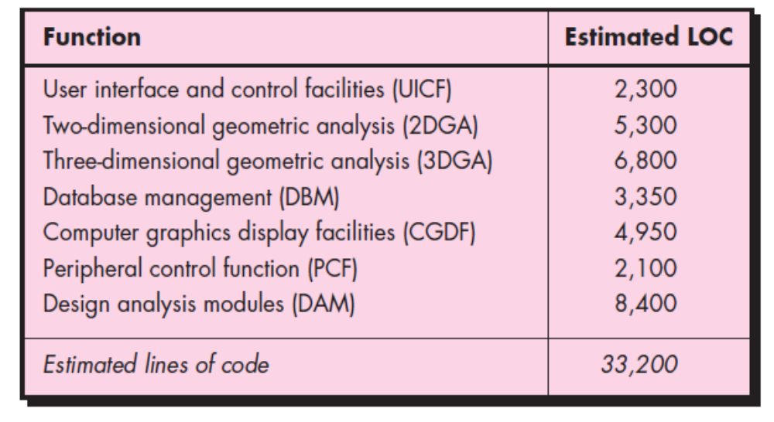
For our purposes, assume that further refinement has occurred and that the major software functions listed in Figure are identified. Following the decomposition technique for LOC, an estimation table is developed.
Dept of CSE

Slide 88
By summing vertically in the estimated LOC column, an estimate of 33,200 lines of code is established for the CAD system.
A review of historical data indicates that the organizational average productivity for systems of this type is 620 LOC/pm.
Based on a burdened labor rate of $8000 per month, the cost per line of code is approximately $13.
Based on the LOC estimate and the historical productivity data, the total estimated project cost is $431,000 and the estimated effort is 54 person-months
Dept of CSE

Slide 89
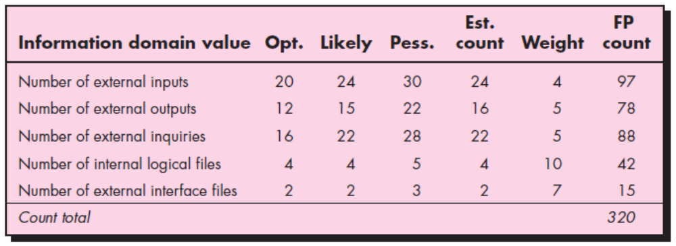
An Example of FP-Based Estimation:
Decomposition for FP-based estimation focuses on information domain values rather than software functions. Referring to the table presented in below Figure, you would estimate inputs, outputs, inquiries, files, and external interfaces for the CAD software.
Below Figure presents the results of this estimate.
Dept of CSE

Slide 90
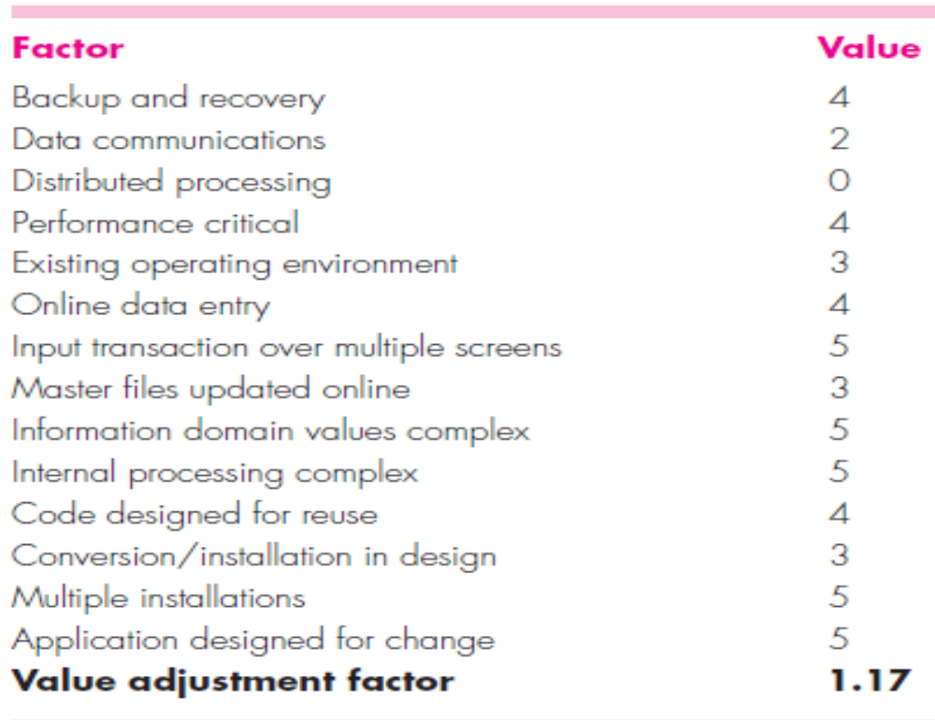
Est Count=(Sopt + 4Sm + Spess)/6
FPCount=Est Count*weight
Each of the complexity weighting factors is estimated, and the value adjustment factor is computed.
Dept of CSE

Slide 91
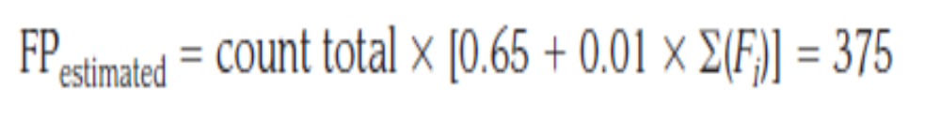
Finally, the estimated number of FP is derived:
The organizational average productivity for systems of this type is 6.5 FP/pm.
Based on a burdened labor rate of $8000 per month, the cost per FP is approximately $1230.
Based on the FP estimate and the historical productivity data,
the total estimated project cost is $461,000 and the estimated effort is 58 person-months.
Dept of CSE

Slide 92
5.2.3 Process-Based Estimation:
The most common technique for estimating a project is to base the estimate on the process that will be used.
That is, the process is decomposed into a relatively small set of tasks and the effort required to accomplish each task is estimated.
Like the problem-based techniques, process-based estimation also follows some steps.
  The functions of the software are identified.
  A series of framework activities must be performed for each function.
  Estimate effort to complete each software function.
  Apply average labor rates, compute the total cost and compare the estimates.
Dept of CSE

Slide 93
An Example of Process-Based Estimation
To illustrate the use of process-based estimation, consider the CAD software introduced in the above Section.
The system configuration and all software functions remain unchanged and are indicated by project scope.
Referring to the completed process-based table shown in the below Figure , estimates of effort (in person-months) for each software engineering activity are provided for each CAD software function.
Dept of CSE

Slide 94
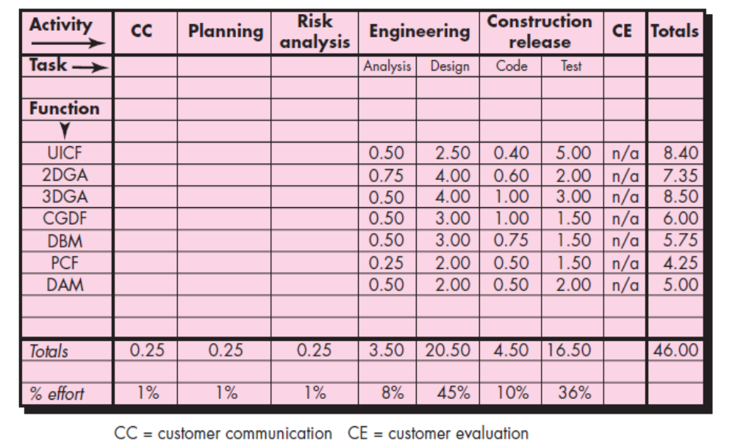
Dept of CSE

Slide 95
The engineering and construction release activities are subdivided into the major software engineering tasks shown.
Gross estimates of effort are provided for customer communication, planning, and risk analysis. These are noted in the total row at the bottom of the table.
Horizontal and vertical totals provide an indication of estimated effort required for analysis, design, code, and test. It should be noted that 53 percent of all effort is expended on front-end engineering tasks (requirements analysis and design), indicating the relative importance of this work.
Based on an average burdened labor rate of $8000 per month, the total estimated project cost is $368,000 and the estimated effort is 46 person-months. If desired, labor rates could be associated with each framework activity or software engineering task and computed separately.
Dept of CSE

Slide 96
5.2.4Estimation with Use Cases:
Use cases provide a software team with insight into software scope and requirements.
However, developing an estimation approach with use cases is problematic for the following reasons:
  Use cases are described using many different formats and styles—there is no standard form.
  Use cases represent an external view (the user’s view) of the software and can therefore be written at many different levels of abstraction.
  Use cases do not address the complexity of the functions and features that are described.
  Use cases can describe complex behavior (e.g., interactions) that involve many functions and features.
Dept of CSE

Slide 97
Unlike an LOC or a function point, one person’s “use case” may require months of effort while another person’s use case may be implemented in a day or two.
Although a number of investigators have considered use cases as an estimation input, no proven estimation method has emerged to date.
Before use cases can be used for estimation, the level within the structural hierarchy is established, the average length (in pages) of each use case is determined, the type of software (e.g., real-time, business, engineering/scientific, WebApp, embedded) is defined, and a rough architecture for the system is considered.
Once these characteristics are established, empirical data may be used to establish the estimated number of LOC or FP per use case.
Dept of CSE

Slide 98
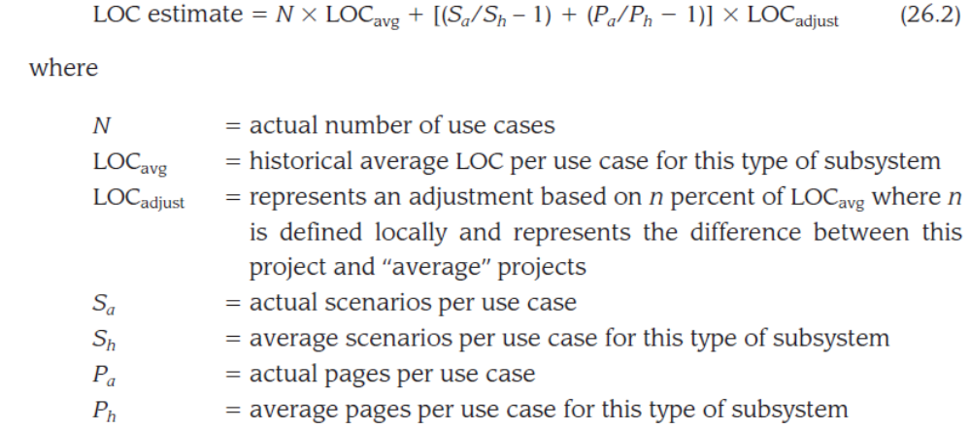
To illustrate how this computation might be made, consider the following relationship:
Expression (26.2) could be used to develop a rough estimate of the number of LOC based on the actual number of use cases adjusted by the number of scenarios and the page length of the use cases. The adjustment represents up to n percent of the historical average LOC per use case.
Dept of CSE

Slide 99
An Example of Use-Case–Based Estimation:
The CAD software introduced in the above Section is composed of three subsystem groups:
  user interface subsystem (includes UICF)- 6 use cases describe the user interface subsystem. Each use case is described by no more than 10 scenarios and has an average length of 6 pages.
  engineering subsystem group (includes the 2DGA, 3DGA, and DAM subsystems)- The engineering subsystem group is described by 10 use cases. Each of these use cases has no more than 20 scenarios associated with it and has an average length of 8 pages.
  infrastructure subsystem group (includes CGDF and PCF subsystems)- the infrastructure subsystem group is described by 5 use cases with an average of only 6 scenarios and an average length of 5 pages.
Dept of CSE

Slide 100
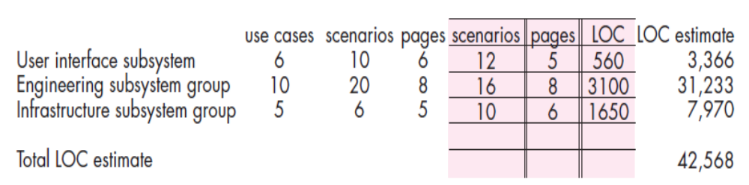
Using the relationship noted in Expression with n=30 percent, the table shown below is developed. Considering the first row of the table, historical data indicate that UI software requires an average of 800 LOC per use case when the use case has no more than 12 scenarios and is described in less than 5 pages.
These data conform reasonably well for the CAD system. Hence the LOC estimate for the user interface subsystem is computed using expression (26.2). Using the same approach, estimates are made for both the engineering and infrastructure subsystem groups.
Dept of CSE

Slide 101
The above table summarizes the estimates and indicates that the overall size of the CAD is estimated at 42,500 LOC.
Using 620 LOC/pm as the average productivity for systems of this type and a burdened labor rate of $8000 per month, the cost per line of code is approximately $13. Based on the use-case estimate and the historical productivity data, the total estimated project cost is $552,000 and the estimated effort is 68 personmonths.
Dept of CSE

Slide 102
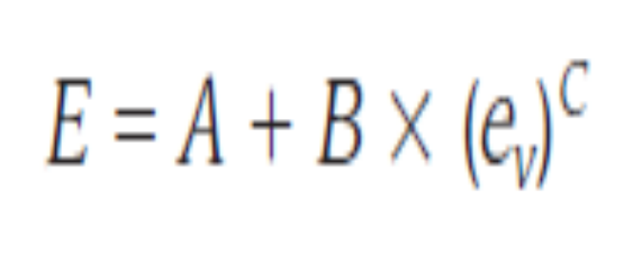
5.3 Empirical Estimation Models:
An estimation model for computer software uses empirically derived formulas to predict effort as a function of LOC or FP.
Values for LOC or FP are estimated using the approach described in the above section 5.2.
5.3.1 The Structure of Estimation Models
A typical estimation model is derived using regression analysis on data collected from past software projects. The overall structure of such models takes the form.
where A, B, and C are empirically derived constants, E is effort in person-months, and ev is the estimation variable (either LOC or FP).
Dept of CSE

Slide 103
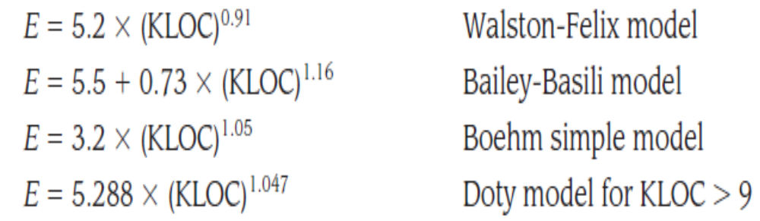
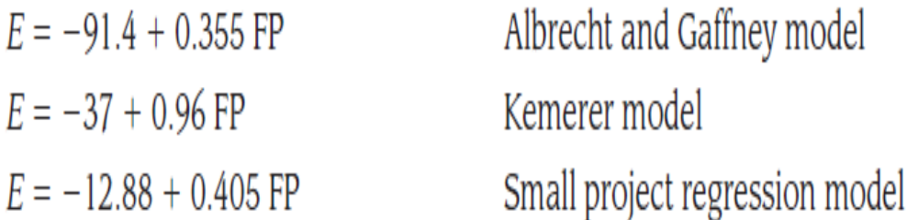
Among the many LOC-oriented estimation models proposed in the literature are
FP-oriented models have also been proposed. These include
Dept of CSE

Slide 104
6. Maintenance, Reengineering, Configuration Management
Dept of CSE

Slide 105
6.1 Software Maintenance:
Software maintenance is the process of changing, modifying, and updating software to keep up with customer needs.
Software maintenance is done after the product has been delivered to the customer.
Software maintenance is a part of the Software Development Life Cycle.
Software maintenance include fixing bugs, adding new features, improving performance, or updating the software to work with new hardware or software systems.
The goal of software maintenance is to keep the software system working correctly, efficiently, and securely, and to ensure that it continues to meet the needs of the users.
Dept of CSE

Slide 106
Need for Maintenance:Software Maintenance is needed for:-
Correct errors
Change in user requirement with time
Changing hardware/software requirements
To improve system efficiency
To optimize the code to run faster
To modify the components
To reduce any unwanted side effects.
Improve the design.
Implement enhancements.
Interface with other systems.
Dept of CSE

Slide 107
Types of Software Maintenance:
In a software lifetime, type of maintenance may vary based on its nature. It may be just a routine maintenance tasks as some bug discovered by some user or it may be a large event.
Types of Software Maintenance are
  Corrective maintenance
  Adaptive maintenance
  Perfective maintenance
  Preventive maintenance
Dept of CSE

Slide 108
Corrective maintenance: Corrective maintenance of a software product is to rectify bugs or errors observed by the customer while the system is in use, or to enhance the performance of the system.
Adaptive maintenance: This includes modifications and updations when the customers need the product to run on new platforms, on new operating systems, or when they need the product to interface with new hardware and software.
Perfective maintenance: A software product needs maintenance to support the new features that the users want or to change different types of functionalities of the system according to the customer demands.
Preventive maintenance: This type of maintenance includes modifications and updations to prevent future problems of the software. It goals to attend problems, which are not significant at this moment but may cause serious issues in future.
Dept of CSE

Slide 109
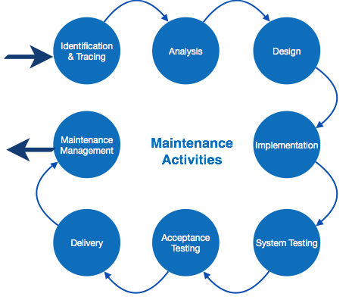
Software Maintenance Process:
The software maintenance process involves various software maintenance techniques that can change according to the type of maintenance.Most software maintenance process models include the following steps:
Dept of CSE

Slide 110
1. Identification & Tracing – The process of determining what part of the software needs to be modified (or maintained). This can be user-generated or identified by the software developer itself depending on the situation and specific fault.
2. Analysis – The process of analyzing the suggested modification including understanding the potential effects of such a change. This step typically includes cost analysis to understand if the change is financially worthwhile.
3. Design – Designing the new changes using requirement specifications
4. Implementation – The process of implementing the new modules by programmers.
5. System Testing – Before being launched, the software and system must be tested. This includes the module itself, the system and the module, and the whole system at once.
Dept of CSE

Slide 111
6. Acceptance Testing- Users test the modification for acceptance. This is an important step as users can identify ongoing issues and generate recommendations for more effective implementation and changes.
7. Delivery - After acceptance test, the system is deployed all over the organization either by small update package or fresh installation of the system. The final testing takes place at client end after the software is delivered. Training facility is provided if required, in addition to the hard copy of user manual.
8. Maintenance management - Configuration management is an essential part of system maintenance. It is aided with version control tools to control versions, semi-version or patch management.
Dept of CSE

Slide 112
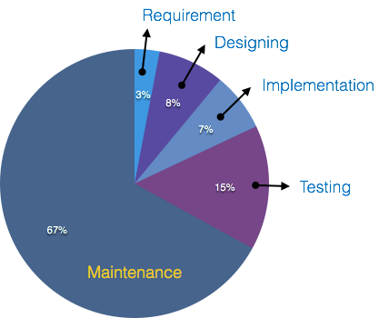
Cost of Maintenance:
The cost of software maintenance can be high.
In certain cases, software maintenance can cost up to two-thirds of the entire software process cycle or more than 50% of the SDLC processes.
Dept of CSE

Slide 113
The costs involved in software maintenance are due to multiple factors and vary depending on the specific situation.
The older the software, the more maintenance will cost, as technologies (and coding languages) change over time. Revamping an old piece of software to meet today’s technology can be an exceptionally expensive process in certain situations.
Older softwares, which were meant to work on slow machines with less memory and storage capacity cannot keep themselves challenging against newly coming enhanced softwares on modern hardware.
In addition, engineers may not always be able to target the exact issues when looking to upgrade or maintain a specific piece of software. This causes them to use a trial and error method, which can result in many hours of work.
Dept of CSE

Slide 114
Often, changes made can easily hurt the original structure of the software, making it hard for any subsequent changes.
Changes are often left undocumented which may cause more conflicts in future.
There are certain ways to try and bring down software maintenance costs. These include optimizing the top of programming used in the software, strong typing, and functional programming.
When creating new software as well as taking on maintenance projects for older models, software companies must take software maintenance costs into consideration. Without maintenance, any software will be obsolete and essentially useless over time.
Dept of CSE

Slide 115
6.2 Reengineering:
To Understand Reengineering let us discuss a small scenario:
Scenario: An application has served the business needs of a company for 10 or 15 years. During that time it has been corrected, adapted, and enhanced many times. People approached this work with the best intentions, but good software engineering practices were always shunted to the side (due to the press of other matters). Now the application is unstable. It still works, but every time a change is attempted, unexpected and serious side effects occur. Yet the application must continue to evolve. What to do?
Sol:We need to Reengineer the software to make it use.
To make legacy software systems easier to maintain, you can reengineer these systems to improve their structure and understandability.
Dept of CSE

Slide 116
Def: Software Re-Engineering is the examination and
alteration of a system to reconstitute it in a new form. This
process encompasses a combination of sub-processes like reverse engineering, forward engineering, reconstructing etc.
software re-engineering, is the process of analyzing, designing, and modifying existing software systems to improve their quality, performance, and maintainability. This can include updating the software to work with new hardware or software platforms, adding new features, or improving the software’s overall design and architecture.
Reengineering may involve redocumenting the system, refactoring the system architecture, translating programs to a modern programming language, and modifying and updating the structure and values of the system’s data. The functionality of the software is not changed and, normally, you should try to avoid making major changes to the system architecture.
Dept of CSE

Slide 117
Software re-engineering can be initiated for various reasons, such as:
Improving software quality: Re-engineering can help improve the quality of software by eliminating defects, improving performance, and enhancing reliability and maintainability.
Updating technology: Re-engineering can help modernize the software system by updating the technology used to develop, test, and deploy the system.
Enhancing functionality: Re-engineering can help enhance the functionality of the software system by adding new features or improving existing ones.
Resolving issues: Re-engineering can help resolve issues related to scalability, security, or compatibility with other systems.
Dept of CSE

Slide 118
A Software Reengineering Process Model:
Reengineering takes time, it costs significant amounts of money, and it absorbs resources that might be otherwise occupied on immediate concerns.
For all of these reasons, reengineering is not accomplished in a few months or even a few years.
Reengineering of information systems is an activity that will absorb information technology resources for many years.
That’s why every organization needs a pragmatic strategy for software reengineering.
Reengineering is a rebuilding activity. To better understand it, consider an analogous activity: the rebuilding of a house.
Consider the following situation. You’ve purchased a house in another state. You’ve never actually seen the property, but you acquired it at an amazingly low price, with the warning that it might have to be completely rebuilt. How would you proceed?
Dept of CSE

Slide 119
Before you can start rebuilding, it would seem reasonable to inspect the house. To determine whether it is in need of rebuilding, you (or a professional inspector) would create a list of criteria so that your inspection would be systematic.
Before you tear down and rebuild the entire house, be sure that the structure is weak. If the house is structurally sound, it may be possible to “remodel” without rebuilding (at much lower cost and in much less time).
Before you start rebuilding be sure you understand how the original was built. Take a peek behind the walls. Understand the wiring, the plumbing, and the structural internals. Even if you trash them all, the insight you’ll gain will serve you well when you start construction.
Dept of CSE

Slide 120
If you begin to rebuild, use only the most modern, long-lasting materials. This may cost a bit more now, but it will help you to avoid expensive and time-consuming maintenance later.
If you decide to rebuild, be disciplined about it. Use practices that will result in high quality—today and in the future.
Dept of CSE

Slide 121
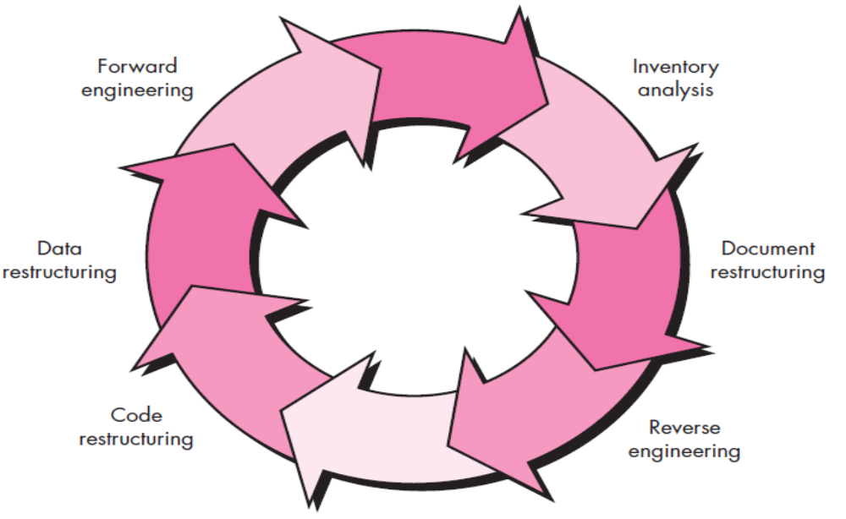
software reengineering process model defines six activities shown in Figure
Dept of CSE

Slide 122
1. Inventory Analysis:
Every software organization should have an inventory of all the applications
Inventory can be nothing more than a spreadsheet model containing information that provides a detailed description (e.g., size, age, business criticality) of every active application.
By sorting this information according to business criticality, longevity, current maintainability, and other local important criteria, candidates for re-engineering appear.
The resource can then be allocated to a candidate application for re-engineering work.
Dept of CSE

Slide 123
2. Document reconstructing:
Documentation of a system either explains how it operates or how to use it.
Documentation must be update,Full re-documentation of an application may not be necessary. Rather, those portions of the system that are currently undergoing change are fully document.
Over time, a collection of useful and relevant documentation will evolve.
Dept of CSE

Slide 124
2. Reverse Engineering:
Reverse Engineering is also known as backward engineering, is the process of forward engineering in reverse. In this, the information are collected from the given or exist application. It takes less time than forward engineering to develop an application. In reverse engineering the application are broken to extract knowledge or its architecture.
Reverse engineering is mostly use to deconstruct or test a product to see how it works. It is mostly done by companies to evaluate their competitor’s latest invention and create something new out of it. it’s more like uncovering secrets of the product to change it according to your needs. It involves prior knowledge regarding the device followed by identifying the system components and investigating relationship between them.
Dept of CSE

Slide 125
Reverse engineering for software is quite similar. In most cases, however, the program to be reverse engineered is not a competitor’s. Rather, it is the company’s own work (often done many years earlier).
The “secrets” to be understood are obscure because no specification was ever developed.
Therefore, reverse engineering for software is the process of analyzing a program in an effort to create a representation of the program at a higher level of abstraction than source code.
Reverse engineering is a process of design recovery. Reverse engineering tools extract data, architectural, and procedural design information from an existing program.
Dept of CSE

Slide 126
4. Code Restructuring: The most common type of reengineering is code restructuring.
Some legacy systems have a relatively solid program architecture, but individual modules were coded in a way that makes them difficult to understand, test, and maintain. In such cases, the code within the suspect modules can be restructured.
To accomplish this activity, the source code is analyzed using a restructuring tool.
Violations of structured programming constructs are noted and code is then Restructured or even rewritten in a more modern programming language.
The resultant restructured code is reviewed and tested to ensure that no anomalies have been introduced. Internal code documentation is updated.
Dept of CSE

Slide 127
5. Data Restructuring: A program with weak data architecture will be difficult to adapt and enhance. In fact, for many applications, information architecture has more to do with the long-term viability of a program than the source code itself.
Unlike code restructuring, which occurs at a relatively low level of abstraction,data restructuring is a full-scale reengineering activity. In most cases, data restructuring
begins with a reverse engineering activity.
Current data architecture is dissected, and necessary data models are defined.
Data objects and attributes are identified, and existing data structures are reviewed for quality.
Dept of CSE

Slide 128
6. Forward Engineering: In an ideal world, applications would be rebuilt using an automated “reengineering engine.” The old program would be fed into the engine, analyzed, restructured, and then regenerated in a form that exhibited the best aspects of software quality.
In the short term, it is unlikely that such an “engine” will appear, but vendors have introduced tools that provide a limited subset of these capabilities that addresses specific application domains.
The forward engineering process applies software engineering principles, concepts, and methods to re-create an existing application. In most cases, forward engineering does not simply create a modern equivalent of an older program. Rather, new user and technology requirements are integrated into the reengineering effort. The redeveloped program extends the capabilities of the older application.
Dept of CSE

Slide 129
6.3 Configuration Management:
Whenever a software is build, there is always scope for improvement and those improvements brings changes in picture.
Changes may be required to modify or update any existing solution or to create a new solution for a problem.
Requirements keeps on changing on daily basis and so we need to keep on upgrading our systems based on the current requirements and needs to meet desired outputs.
Changes should be analyzed before they are made to the existing system, recorded before they are implemented, reported to have details of before and after, and controlled in a manner that will improve quality and reduce error.
This is where the need of software Configuration Management comes.
Dept of CSE

Slide 130
SCM is the discipline which
  Identify change
  Monitor and control change
  Ensure the proper implementation of change made to the item.
  Auditing and reporting on the change made.
Configuration Management (CM) is a technic of identifying, organizing, and controlling modification to software being built by a programming team. The objective is to maximize productivity by minimizing mistakes (errors).
Dept of CSE

Slide 131
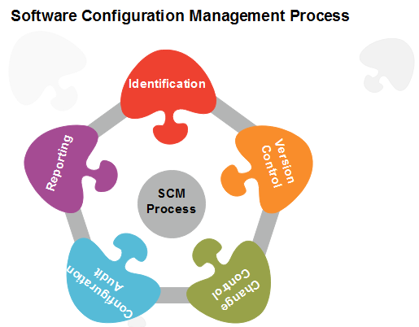
SCM Process:
Configuration management provides a disciplined environment for smooth control of work products. It involves the following activities:
Dept of CSE

Slide 132
Identification and Establishment – Identifying the configuration items from products that compose baselines at given points in time. Establishing relationship among items, creating a mechanism to manage multiple level of control and procedure for change management system.
Version control:
  Version Control involves a set of procedures and tools used to manage and maintain various versions of configuration objects generated during the software development process.
  In the context of Software Configuration Management (SCM), version control is defined by Clemm as a means to enable users to select and specify different configurations of the software system through appropriate versions.
  This is achieved by associating specific attributes with each software version and allowing users to construct a desired configuration by selecting the desired attributes.
Dept of CSE

Slide 133
Change Control : James Bach highlights the importance of change control in the context of Software Configuration Management (SCM), but acknowledges that it can also be a challenging and frustrating process.
Changes in software are closely monitored because even a small error in code can result in significant product failure, but it can also bring about improvements and new capabilities.
While there is a risk that a single developer could negatively impact a project, creative ideas often come from these individuals, and a burdensome change control process may discourage such innovation.
Change requests undergo technical evaluations to assess their impact on other configuration objects, system functions, and the projected cost of the change, with the results presented in a change report.
Dept of CSE

Slide 134
The final decision on the status and priority of the change is made by a change control authority (CCA).
The “check-in” and “check-out” process facilitates two important elements of change control: access control, which governs the software engineers who have permission to modify a specific configuration object, and synchronization control, which helps prevent conflicts between parallel changes made by different individuals.
Dept of CSE

Slide 135
Configuration Audit: In Software Configuration Management (SCM), audits are conducted to ensure that the software product meets the specified baseline requirements and that there is consistency between what is built and what is delivered.
SCM audits also ensure that traceability is maintained between all Configuration Items (CIs) and that all work requests are associated with one or more CI modifications.
SCM audits serve as “watchdogs” to ensure the preservation of the project’s scope and integrity.
Dept of CSE

Slide 136
Status Reporting: Configuration Status Reporting, also known as status accounting, is the process of providing up-to-date configuration data and accurate status information to various stakeholders, including developers, testers, end-users, customers, and other interested parties.
This information can be shared through a variety of resources, such as administrative guides, user guides, frequently asked questions (FAQs), release notes, installation guides, configuration guides, and other relevant documentation.
Dept of CSE

Slide 137
Benefits of Software Configuration Management Process
Multi-User Updates: SCM allows tracking of all code and configurations deployed into production and provides traceability by identifying the contributor for each update, enabling effective collaboration among multiple developers.
Change Accommodation: SCM makes it easier to accommodate changes in schedule, policy, and users, making the software development process more flexible.
Platform and OS Testing: SCM ensures that the software runs effectively across multiple platforms and operating systems, enhancing its compatibility.
Productivity: SCM minimizes errors and ensures that test and production environments match, enhancing productivity and software quality.
Communication and Collaboration: SCM enables easy communication and collaboration among team members and stakeholders, improving the quality of the product.
Cost Control: SCM helps to track team members and project workflow, which results in increased efficiency, better cost control, and reduced expenses.
Dept of CSE

Slide 138
Advantages of SCM
Increased Productive Efficiency: SCM helps to control and track the software development process, resulting in increased productive efficiency.
Change Management: SCM allows for effective change management, reducing the risk of the product.
Monitoring and Auditing: SCM enables proper monitoring and auditing of the software development product, ensuring its quality.
Enhanced Software Development Life Cycle Process: SCM enhances the software development life cycle process, improving the overall quality of the product.
Reliable, Organized, Cost-effective, and Low-risk: SCM provides a reliable, organized, cost-effective, and low-risk software development application.
High-quality Software Product: SCM ensures the delivery of high-quality software products.
Dept of CSE

Slide 139
Disadvantages of Software Configuration Management
Implementing software configuration management requires significant resources, including a team with expertise in SCM tools and processes.
Small industries may find it challenging to allocate the necessary resources to implement SCM effectively.
Development stages may require high-performance hardware to support SCM tools and processes.
Dept of CSE

Slide 140

Dept of CSE

